Slide 1
Webinar: Using Type to Implement Change
Brought to you by Psychometrics Canada

Slide 2
Workshop Objectives
To understand how type impacts how we evaluate and implement change
To explore the different elements of change
To use type to navigate effective change

Slide 3
Evaluating Change
What does change mean to you?
Positive? Negative? Neutral?

Slide 4
The Essential Nature of Change
Kathleen Eisenhardt, 2010
Microfoundations of Performance: Balancing Efficiency and Flexibility in Dynamic Environments
Organizational success arises from being able to change in response to environmental demand, or fleeting windows of opportunity, while maintaining systems and protocol that work
Implementing change is not as easy as it sounds; inherently complex

Slide 5
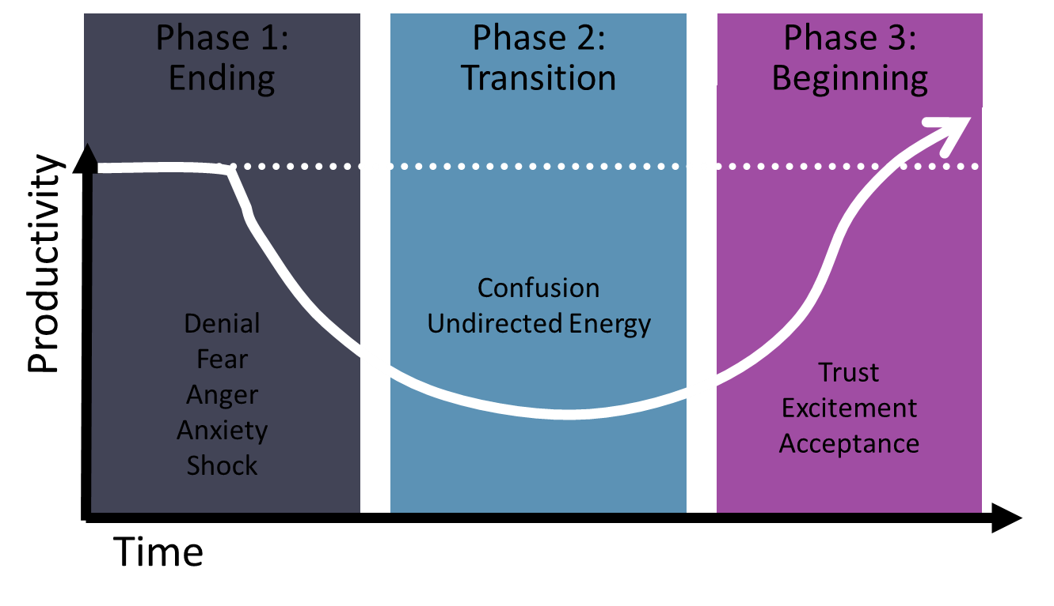
Bridges’ Model of Transition

Slide 6
Difficult Transition is compounded by
Different types of change require differing amounts of effort to manage
People are attracted to different ideas: “One person’s perfume is another person’s poison”
Individuals differ in what they need to know during times of change

Slide 7
Types of Change
Efficiency: doing the right things the right way
Refining: doing things better
Adopting: Doing things others are doing elsewhere
Different: Doing things no one else is doing
Notes:
Efficiency: Doing the right things the right way!
The production of the desired effects or results with minimum waste of time, effort, or skill.
Refining: Doing things better!
Bringing products or the organization into line with customer needs or demands.
Adopting: Doing things others are doing elsewhere!
Finding ideas from other organizations and implementing them into yours.
Different: Doing things no one else is doing!
Implementing something completely new and novel.

Slide 8
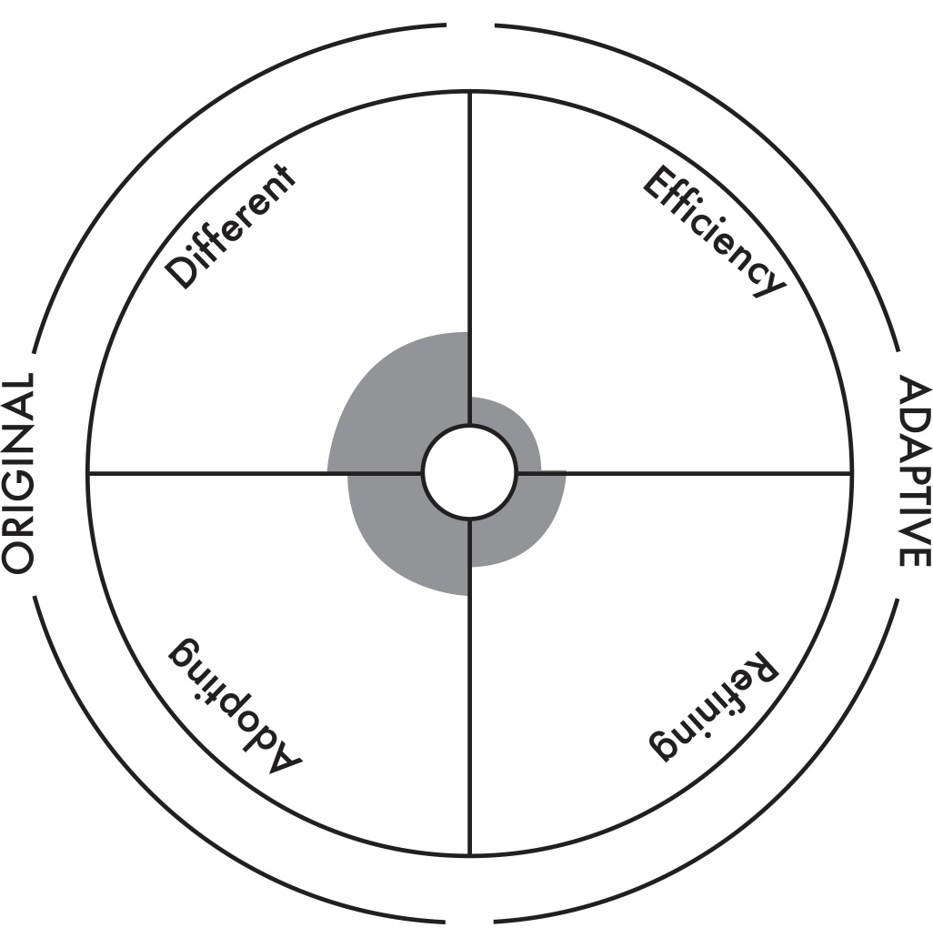
Types of change

Slide 9
Activity: What do you need?
Form groups of SJ, SP, NP, NJ
Discuss and jot down “What kind of change do you like?”

Slide 10
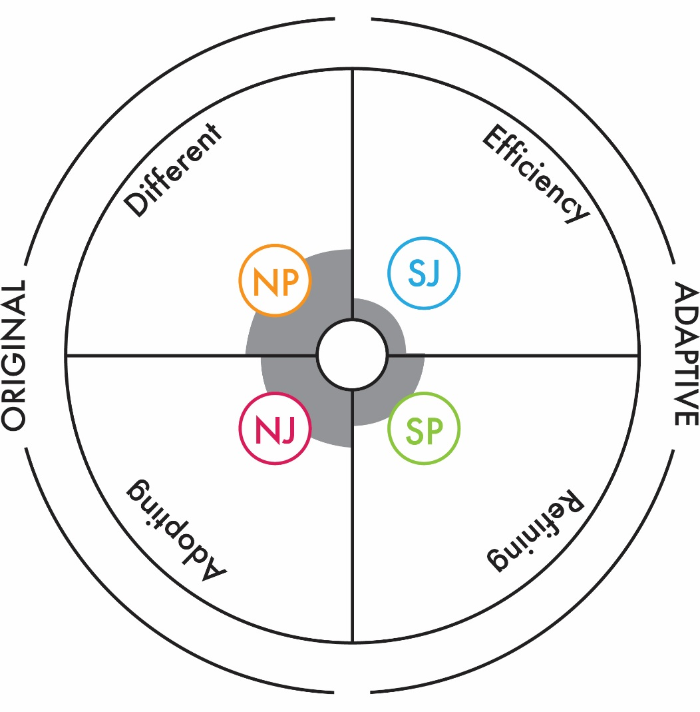
Change and Personality preferences

Slide 11
Therefore, introducing change…
Requires that we speak ‘different languages’ to ensure buy-in, convince others of value, and give everyone what they need to feel confident moving forward
Frame the change through all 4 lenses: efficiency, refinement, adopting, and different

Slide 12
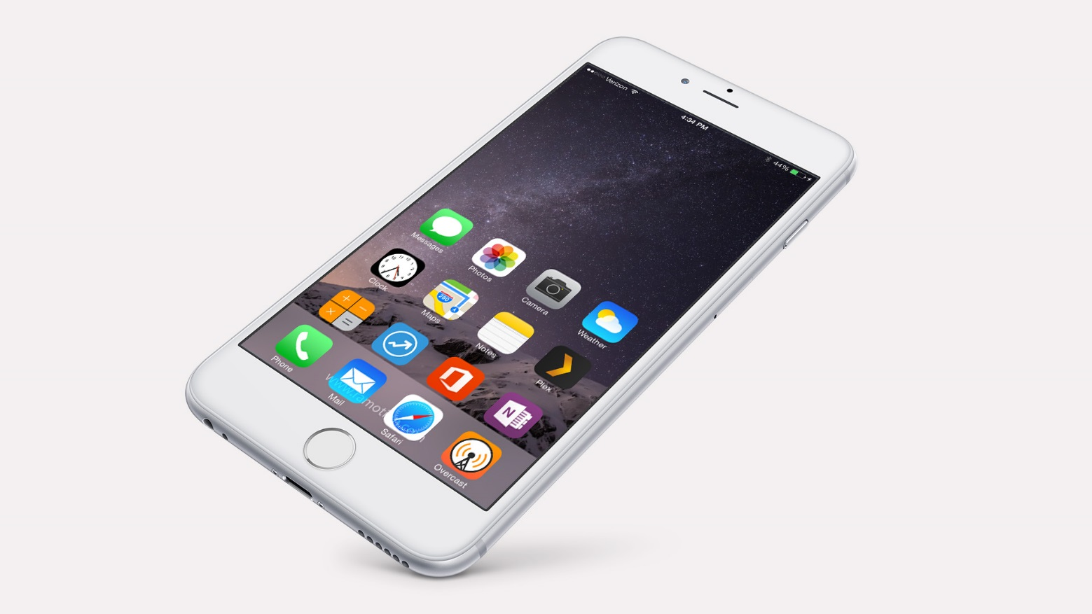
An Example

Slide 13
Reflections on this Organization
How would you classify the nature of most of the change here?
How is the need for change currently being communicated?

Slide 14
Implementation of Change
Success of the change relies on both introduction and implementation
Implementation – just like introduction – of change requires mindful and intentional consideration of all preference groups

Slide 15
The Implementation Cycle
Define: Understand the problems and the issues
Discover: Generate more ideas or better quality ideas; explore alternatives
Decide: Turn ideas into solutions by picking the most viable options
Deliver: Deliver results, implement solutions

Slide 16
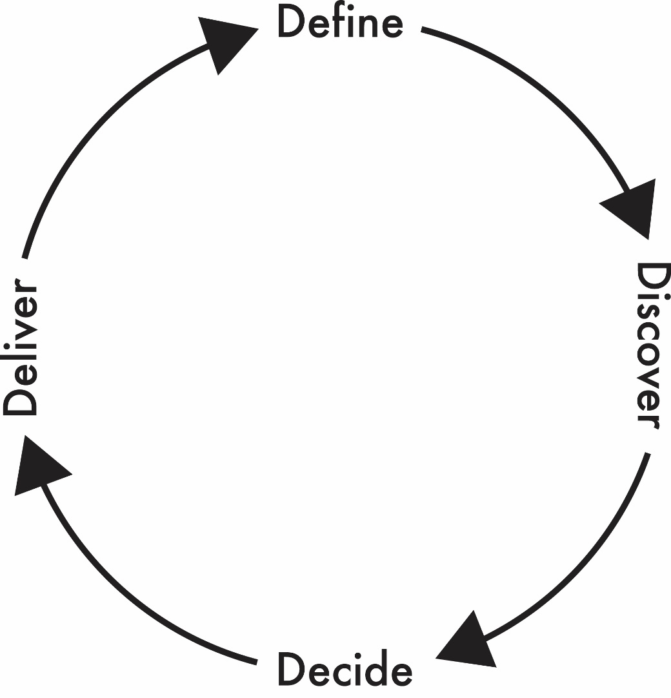
The Implementation Cycle
“What’s the problem?”
Deliver and implement solutions
“What are all the ideas and alternatives?”
Turn ideas into solutions by picking the most viable options

Slide 17
The dangers of ‘too much of one’
Case Study 1: Too much deliver, not enough define?
Case Study 2: Too much discover, not enough deliver?

Slide 18
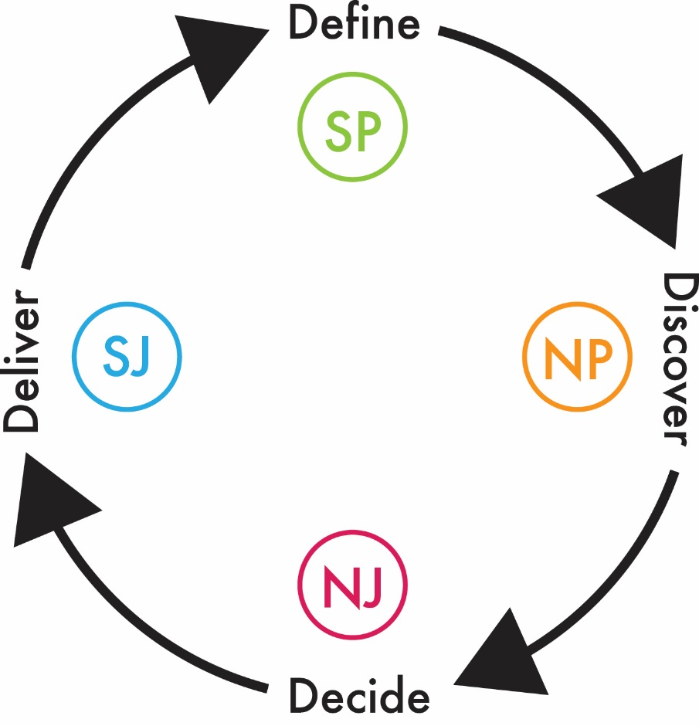
The impact of personality
Different types will default to each phase more naturally than others
“What’s the problem?”
Deliver and implement solutions
“What are all the ideas and alternatives?”
Turn ideas into solutions by picking the most viable options

Slide 19
Implications
Important to be patient with the process and consider all phases and perspectives
Successful change implementation means adjusting your own style at certain stages in the process
Mindful change implementation makes for optimal engagement of people towards the change…and more effective changes!

Slide 20





Group Change Analysis
Notes:
Questions to ask: Are we overemphasizing/underemphasizing a part of the implementation cycle as a result of our distribution?
Can you give me any examples of this pattern exemplified in a change?
What do we need to focus more on as a group moving forward to more effectively navigate change?

Slide 21
Consider your approach to change
What kind of changes do you like?
What part of implementing change do you find most natural/enjoyable?
How can you flex this style to ensure you are including other perspectives?
What does this team need to do to more effectively implement change?

Slide 22
Thank-you!
Questions?
amillar@psychometrics.com

Slide 23
Further Resources
Introduction to Type and Change
Nancy Barger & Linda Kirby
Introduction to Type and Innovation
Damian Killen & Gareth Williams
MBTI Teambuilding Program Third Edition
MBTI Type and Change Leader’s Resource Guide
MBTI Type and Change Participant’s Guide
MBTI Practitioner’s Field Guide
amillar@psychometrics.com
www.psychometrics.com

