Slide 1
Fixed and Fluid Traits
Finding Emotional Intelligence Insights From Personality Type
Notes:
Goal of the webinar: To present to you a new way to use the information contained in an individual’s personality type.

Slide 2
Presenter Bio
Justin M. Deonarine
I/O Psychologist
Psychometrics Canada
Notes:
I/O Psychologist with Psychometrics Canada
Formerly involved in the EI field
Led the development of a leadership-based 360-degree emotional intelligence product
Used EI assessments while consulting for Canadian Reality TV shows and within the Canadian music industry
Have written a number of publications on EI, for sources such as Linkedin, HR.com and Choice Magazine
Of note: Co-authored a textbook chapter on EI (Stein and Deonarine, 2015)

Slide 3
Experience with Emotional Intelligence
How familiar are you with Emotional Intelligence?
Notes:
Options:
I’ve heard of emotional intelligence, but have little experience using emotional intelligence assessments.
I have used one or more emotional intelligence assessments.
I would consider myself an emotional intelligence expert.

Slide 4
What is Emotional Intelligence?

Slide 5
Emotional Intelligence
It is very important to understand that emotional intelligence is not the opposite of intelligence, it is not the triumph of heart over head -- it is the unique intersection of both.
David Caruso
Notes:
Broadly defined, EI is the ability to perceive, manage and use your emotions in a constructive way
There are a variety of models that different assessments are based on, but they are all summarized by this broad definition

Slide 6
How is Emotional Intelligence Expressed?
Notes:
Or rather, how are emotionally intelligent behaviours exemplified in the workplace?
(Audience provided examples in the chat box.)
Here are some of the core concepts that arise around emotional intelligence (aka the expected answers):
Self-awareness
Leadership
Empathy
Assertiveness
Teamwork
Stress Tolerance
Communication
Flexibility

Slide 7
Differing Approaches
Trait-based Approach
Ability-based Approach
Notes:
Trait-based measures of EI
Exist in the form of self-report assessments and 360-degree feedback assessments
Are “Fluid” measures
These traits are adaptable (and even coachable), therefore providing avenues for change and growth
Scores can change over time (as the individual undertakes development initiatives)
Ability-based EI
Performance-based assessments
Performance on tasks such as identifying the emotion of the individual in the picture
Responses are compared against expert ratings
Are “Fixed” measures
Treats emotional intelligence like cognitive intelligence: You’re stuck with what you’re born with
An innate level of emotional intelligence is measured, with little to no room for development, but strategies can be formed to harness an individual’s strengths and accommodate for their weaknesses

Slide 8
Fixed vs. Fluid Traits
Notes:
Given that the Ability-based approach assumes that emotional intelligence is unchanging and stable, we won’t be focusing on this approach
However, the idea of “Fixed vs. Fluid Traits” applies well to another concept that we’re all familiar with: Personality
It is well-known that the MBTI measures preferences which are not expected to change over time
MBTI identifies fixed personality preferences
Emotional Intelligence measures fluid personality traits
Fixed personality preferences can help you quickly identify the fluid personality traits to harness (strengths) or develop (challenges)

Slide 9
What is the relationship between Personality and Emotional Intelligence?

Slide 10
Relationship Between Personality and EI? Personality As a Factor of EI
Notes:
(Webb et al., 2013)
Overall, 82% of emotional intelligence scores can be explained by 3 other factors: IQ, Personality and Emotional Well-Being.
Personality alone explains 57% of emotional intelligence scores.
Emotional Well-Being contributes has a small contribution, while IQ can explain 22% of emotional intelligence scores.

Slide 11
Emotionally Intelligent Preferences
Which of these 4 preferences are most related to Emotional Intelligence?
Notes:
Options:
Sensing
Intuition
Thinking
Feeling

Slide 12
Relationship Between Personality and EI? Dichotomies and EI
Total EI Score
E
J
T
Notes:
Overall (or Total) EI scores are positively related with E, T and J. (Higgs, 2000; Thompson, 2006; Murphy, 2006; Barnard & Nel, 2015)
EI measures may have a bias towards E. (Thompson, 2006)

Slide 13
Relationship Between Personality and EI? Dichotomies and EI
Total EI Score
E
J
T
N
Notes:
N was also found to be correlated with higher EI scores. (Higgs, 2000; Murphy, 2006)
Note for Problem Solving scales
Despite N being correlated with higher overall EI, some EI measures may not account well for an intuitive problem solving (favouring a methodological, sensing-based approach).
So, does this mean that ENTJs are the most emotionally intelligent individuals?
One study in particular (Thompson, 2006) suggests that ENTJs possess the highest average Total EI score, with ESTJs scoring a close second.
However, possessing a higher Total EI score doesn’t mean that they excel in every aspect of emotional intelligence.
ENTJs were not in the Top 5 MBTI types for Self-Awareness.

Slide 14
Relationship Between Personality and EI? Dichotomies and EI
F
Total EI Score
Interpersonal Skills
Notes:
But wait…shouldn’t F be a component of overall EI?
This is a reasonable assumption, given major components of EI are Interpersonally based (e.g. Empathy, Teamwork, Interpersonal Relationships).
In fact, F is positively related to Interpersonal scales of EI. (Barnard & Nel, 2015)
However, it is not associated with Intrapersonal elements of emotional intelligence.
As a result, multiple studies have concluded that a preference for Feeling is not associated with overall EI scores. (Higgs, 2000; Thompson, 2006; Murphy, 2006; Barnard & Nel, 2015)

Slide 15
A Broad Perspective
“Maddocks (2004) takes the approach that EI is about managing our Type (personality) and not that some Types have more or less EI than others. He does believe, however, that it would be useful to identify patterns of differences among Types.”
Henry L. Thompson
Notes:
While understanding the connections between Personality Type and EI scores is helpful in drawing connections between the two concepts, let’s not forget the big picture
EI is about managing the strengths and challenges that arise from our Personality Type
Identifying Fluid personality traits to harness and develop based on our Fixed personality traits
Which type has a higher overall EI score is less relevant when we keep in mind that each Personality Type will have different strengths and challenges

Slide 16
How do I find Emotional Intelligence Insights from Personality Type?
Notes:
It’s important to mention here that I will not be focusing on any particular model or assessment of EI.
Recall some of the emotionally intelligent workplace behaviours that we listed earlier. These are the behaviours that we will be focusing on.
As a result, you should be able to draw connections between the content here and your favourite emotional intelligence assessment.

Slide 17
The Starting Point – Mental Functions
Si
Ni
Se
Ne
ISTJ, ISFJ
ESTP, ESFP
INTJ, INFJ
ENTP, ENFP
ISTP, INTP
Ti
Fi
Te
Fe
ESTJ, ENTJ
ISFP, INFP
ESFJ, ENFJ
Notes:
Finding emotional intelligence insights from personality type starts with the Mental Functions
(First phase of the animation) On the following chart, I have specified the Mental Functions, which you may have seen before as the Dominant, Auxiliary, Tertiary and Inferior Functions.
S, N, T and F refer to their respective preferences, while the “e” or “i“ indicates where that preference is extraverted or introverted (aka applied outwardly or inwardly respectively)
Example: Someone with an Se Dominant Function would focus on information gathered in the moment (from external sources), while someone with an Si Dominant Function would focus on information recalled from their experiences
(Second Phase of the animation) These are the Whole Types that use each Mental Function as their Dominant Function.
In other words, the associated Mental Function describes where and how your Whole Type begins to take action.
Example: ESTPs will approach problems by gathering as much information as they can, where an ENTP will look for patterns within the available information.

Slide 18
The Broad Perspective
Self-Awareness
Awareness of Others
Si
Ni
Se
Ne
Ti
Fi
Te
Fe
Self-Management
Relationship Management
Notes:
I’ve grouped these Mental Functions this way for a reason, as this shows their broad relationships to emotional intelligence insights.
Those who focus on Si and Ni Mental Functions tend to excel in self awareness.
Those who focus on Ti and Fi Mental Functions tend to be better at self management.
Those who focus on Se and Ne Mental Functions tend to be more aware of their environment (including others in the environment).
Those who focus on Te and Fe Mental Functions tend to be skilled at managing relationships.

Slide 19
The Detailed Approach Interpersonal or Intrapersonal?
Whole Type
ESTJ
Dominant Function
Te
Auxiliary Function
Si
Notes:
While you can quickly identify the broad areas of focus based on the individual’s Dominant Mental Function, you can also gain insight into specific emotional intelligence strengths and challenges by looking at both the Dominant and Auxiliary Mental Functions.
Each individual will have emotional intelligence strengths and challenges related to both the Inter-personal and Intra-personal worlds.
Extraverted function and Introverted function respectively.
Intrapersonal: Will you spend more efforts towards awareness of your emotions or management of your emotions?
Interpersonal: Will you spend more efforts towards gathering information from the environment or managing/organizing your environment?
In other words, the Dominant and Auxiliary functions can help us determine which emotional intelligence traits are natural to the individual.

Slide 20
The Detailed Approach Interpersonal or Intrapersonal?
Whole Type
ESTJ
Dominant Function
Te
Auxiliary Function
Si
Notes:
In the case of an ESTJ, the individual possesses a Extraverted Thinking dominant function and an Introverted Sensing auxiliary function.
Broadly speaking, this individual will be more effective at managing their environment and being aware of their emotions.
The specific emotional intelligence strengths and challenges for each individual will differ based on their preferences towards S, N, T and F.
So what do these specific strengths and challenges look like?

Slide 21
The Detailed Approach Interpersonal Emotional Intelligence Traits
Se
Ne
Te
Fe
Common Themes
Action-Orientation Connecting with others
Strengths
Adaptability
Initiative
Strategic Vision
Communication
Being Analytical
Planning
Empathy
Tolerance
Challenges
Self-Control
Persistence
Tolerance
Persuasion
Notes:
The list of emotional intelligence strengths and challenges for each of the 8 Mental Functions is quite complicated and lengthy.
As a result, I will not be presenting the full set of Strengths and Challenges here, but they can be found in the free supplement that we will be providing after the webinar.
Keep in mind that these are common strengths and challenges for individuals, but given that we’re looking at fluid traits, these may vary based on experience.
However, you can see some common themes here.
Interpersonal Emotional Intelligence traits tend to focus on action-orientation and connecting with others.

Slide 22
The Detailed Approach Intrapersonal Emotional Intelligence Traits
Si
Ni
Ti
Fi
Common Themes
Self-Awareness Self-Management
Strengths
Self-Control
Persistence
Strategic Vision
Independence
Being Analytical
Realistic
Empathy
Teamwork
Challenges
Emotional Expression
Teamwork
Empathy
Communication
Notes:
On the other hand, Intrapersonal Emotional Intelligence traits tend to focus on awareness and management.

Slide 23
Emotional Intelligence Challenges
What is your greatest Emotional Intelligence challenge?
Notes:
Poll Options:
Self-Awareness
Self-Management
Awareness of Others
Relationship Management

Slide 24
How Have I Applied This In The Past?

Slide 25
Case Study: ENTJ Leader
Notes:
To show you how I’ve combined Personality Type and Emotional Intelligence in the past, I’d like to review a case study with an ENTJ leader.
This individual was a Director (Senior Management level), a position that is a natural fit for ENTJs.
I did have access to emotional intelligence assessment results as part of this case study, which is what I originally used to find the leader’s strengths and challenges.
However, I will also show how they link with common emotional intelligence strengths and challenges for ENTJs.

Slide 26
Case Study: ENTJ Leader
Whole Type
ENTJ
Dominant Function
Te
Auxiliary Function
Ni
Notes:
ENTJ Leader
Extraverted Thinking Dominant Function
Introverted Intuition Auxiliary Function
By the information presented previously, we could expect…
Strengths
Te Dominant Function = Strong with communication and persuasion, resulting in a natural leader.
Ni Auxiliary Function = Reflective about the bigger picture and the future, open to change (flexibility).
Challenge
Awareness of others around them (and how they viewed the leader).
Given that the position is a natural fit for ENTJs, what emotional intelligence challenges did they face as a Director?

Slide 27
Case Study: Strengths
Te
Ni
Analytical Thinking
Strategic Vision
Planning
Adaptability
Initiative
Independence
Persuasion
Creativity
Notes:
Overall, regarded as a strong leader
Possessed tremendous drive towards success, confidently strived towards goals
Possessed great social confidence
Had a strong strategic vision
Showed great adaptability, overcoming many challenges using their analytical skills
Highly independent
A lot of these traits can be seen in the list of common EI traits for ENTJs.

Slide 28
Case Study: Challenges
Te
Ni
Emotional Expression
Teamwork
Tolerance
Communication
Empathy
Realistic
Notes:
May need to focus more on empathetic communication.
Very persuasive, but average empathy.
Q: Is your assertiveness out balance with your empathy, giving the perception of aggression?
Too much independence?
Higher level of independence, but average emphasis on teamwork.
Q: Is your independence hindering your ability to collaborate?
These observations can be seen in the challenges that are common to ENTJs.
Combined, the areas for development focus on this leader’s Emotional Expression, Tolerance, Empathy, Communication, Teamwork.

Slide 29
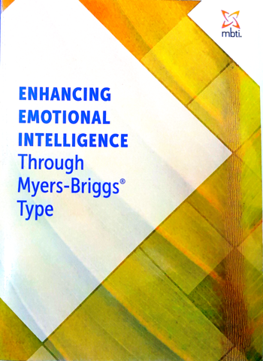
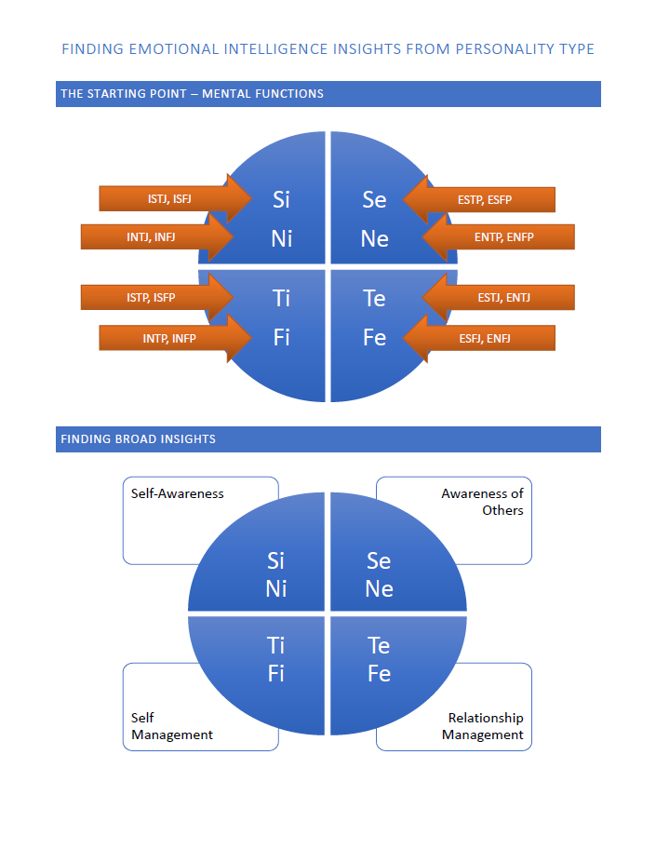
Further Resources: MBTI and EI
Notes:
Roger Pearman’s Type and EI book
To learn more about the interaction between Type and Emotional Intelligence
CPP’s MBTI and EI workshop template
For designing MBTI workshops with an EI focus
“Finding Emotional Intelligence Insights From Personality Type” (Webinar supplement handout)
A review of the content presented in this webinar, as well as content that couldn’t be included here
You can use the handout as a reference guide for finding EI insights from Type

Slide 30
Thank-you!
jdeonarine@psychometrics.com
Justin Deonarine
http://www.psychometrics.com

