Slide 1

Psychometrics
Group Feedback Template

Slide 2

Workshop Purpose and Goals
Learn how to interpret and understand your Psychometrics 360 Report.
Identify important patterns and themes in the feedback you have been given.
Begin to create a development plan to increase your effectiveness.
[Insert Additional Goals]

Slide 3
Why Psychometrics 360° Feedback?
To recognize how others view and interpret your work behaviors.
To identify your skills and strengths.
To identify, accept and work on your developmental needs.
Knowing yourself is a critical factor to a successful career.
Notes:
Self-report influenced by personal biases, your intentions, etc.
How do people, who may not know your intentions, rate your behaviours/skills

Slide 4
The Psychometrics 360° Assessment
Confidential evaluation of 24 work competencies and 125 specific behaviors.
A way to receive feedback from your supervisor, coworkers, direct reports and others.
Focuses on specific behaviors rather than general judgments.

Slide 5
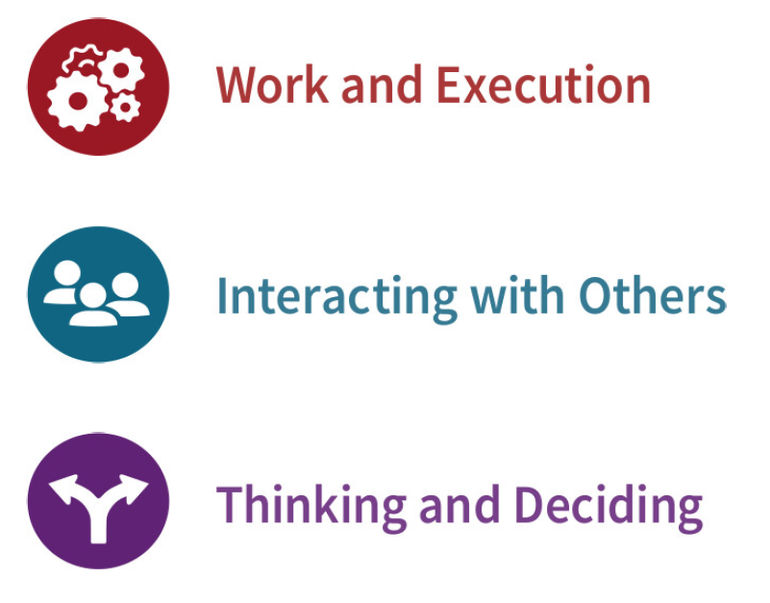
What the Psychometrics 360° Measures
The 24 workplace competencies are grouped into 3 key areas

Slide 6
Reviewing your Psychometrics 360° Feedback
Remember:
  The ratings are opinions – they are how others perceive you.
  There will be surprises, both positive and negative.
  Differences of opinion do not mean the ratings are wrong…these indicate interesting areas to explore.
Focus on:
  How you can further utilize your talents.
  How you can transform feedback into positive change.

Slide 7
Gauge Your Reactions
When you receive higher ratings than expected from others, you may experience:
  Surprise
  Reflection
  Motivation
When you receive lower ratings than expected from others, you may experience:
  Surprise
  Defensiveness
  Resistance

Slide 8
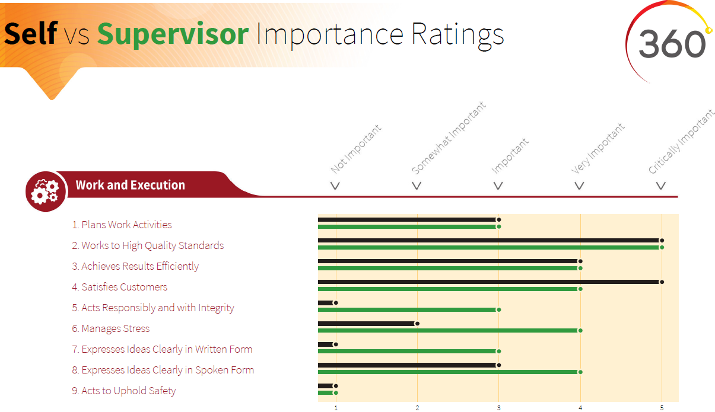
Clarify Priorities
Self and Supervisor Ratings of Competency Importance
Page 2
Notes:
Examine Self and Supervisor Ratings of Competency Importance (p. 2)
Questions to Ask:
Which competencies are agreed to be critically important?
Which competencies are only rated as critically important by you or your supervisor?
How might these differences cause conflict or issues?
Look for gaps in the importance ratings of 2 or more. How might these key differences cause problems for you?
See page 12 in the Psychometrics 360 User’s Guide for Interpretive Tips

Slide 9
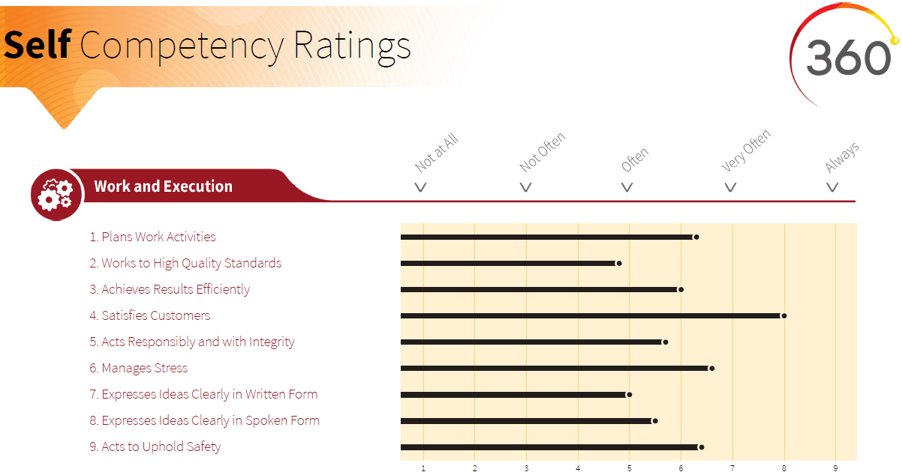
How you see yourself
Self Ratings
Page 3
Notes:
Questions to Ask
Which competencies do you see yourself using most often?
Give examples of when you used those competencies.
Overused?
Could they be leveraged? If used more often would it benefit you?
List the competencies that you identified as using least often
Underused and Needed? – These should be developed.
Give examples of when your lack of skill/comfort in this area tripped you up.
Describe the changes you would like to see
Underused but not Needed? – These you can ignore.
Save your energy by focusing only on priorities and things that matter.

Slide 10
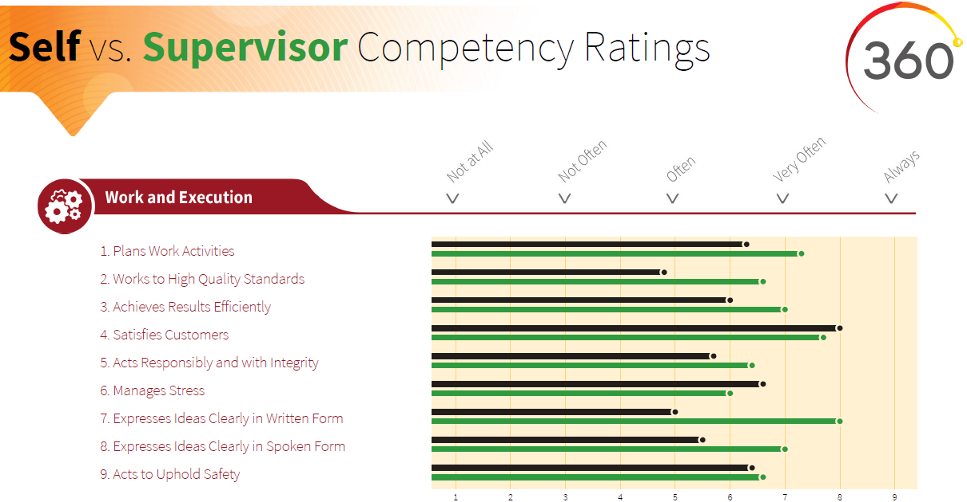
Messages from your Supervisor
Self vs Supervisor Ratings
Page 4
Notes:
See page 13 in the Psychometrics 360 User’s Guide for Interpretive Tips

Slide 11
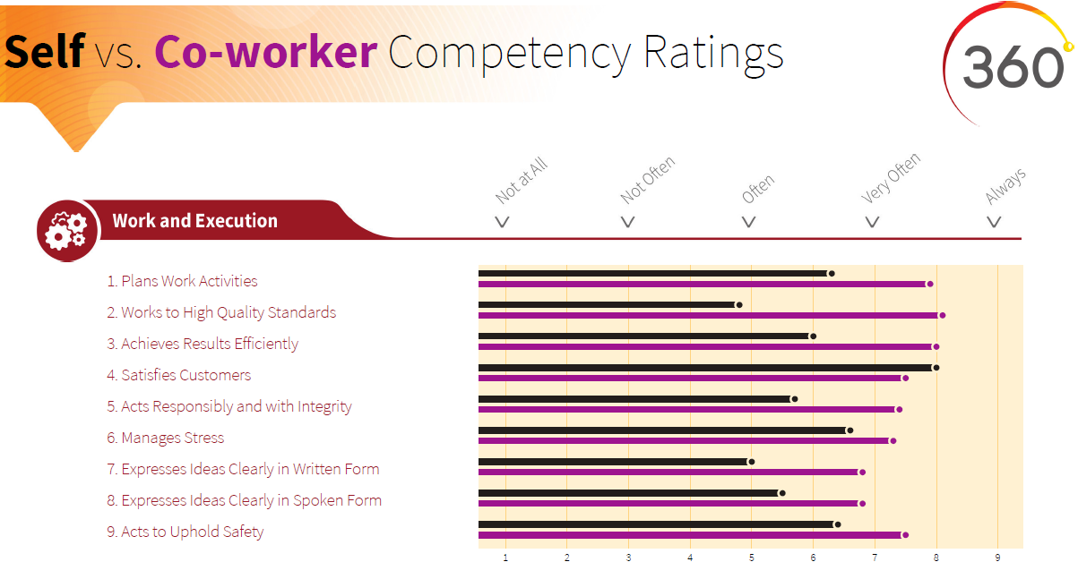
Messages from your Co-workers
Self vs Co-worker Ratings
Page 5
Notes:
See page 13 in the Psychometrics 360 User’s Guide for Interpretive Tips

Slide 12
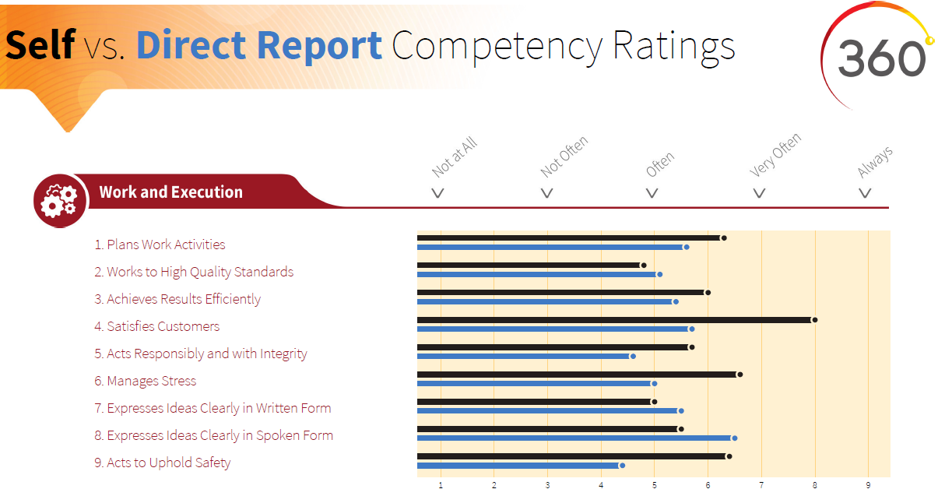
How You are seen as a Leader
Self vs Direct Report Ratings
Page 6
Notes:
See page 13 in the Psychometrics 360 User’s Guide for Interpretive Tips

Slide 13
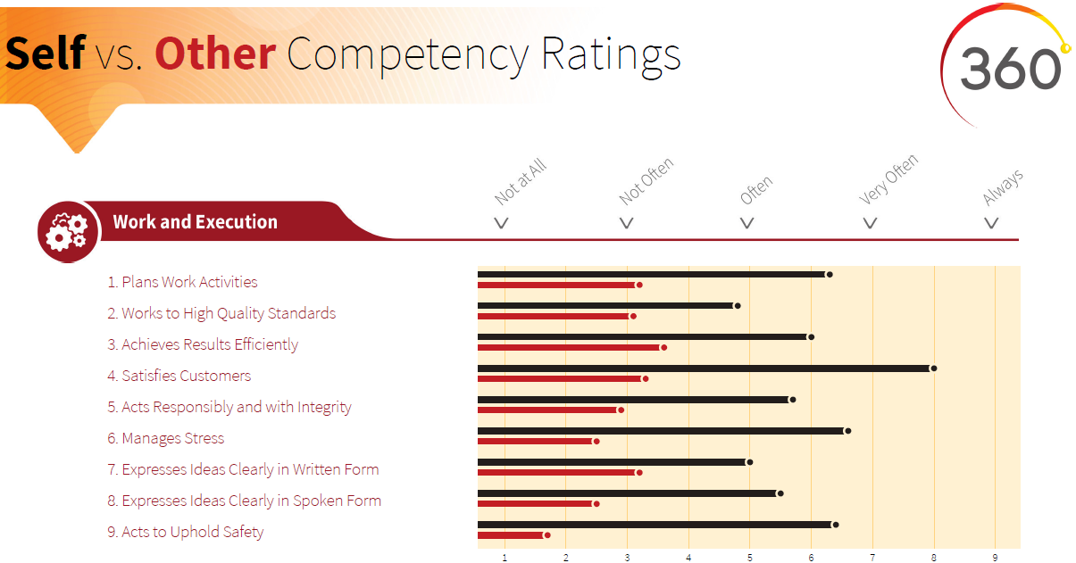
How Others View Your Behaviors
Self vs Others Ratings
Page 7
Notes:
See page 13 in the Psychometrics 360 User’s Guide for Interpretive Tips

Slide 14
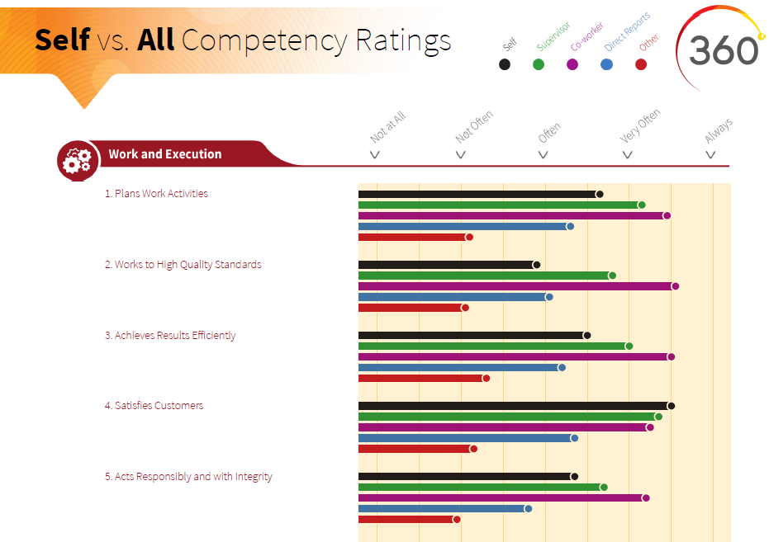
The Global View
Self vs All Ratings
Pages 8-10
Look for patterns across rating groups
Notes:
See page 15 in the Psychometrics 360 User’s Guide for Interpretive Tips

Slide 15
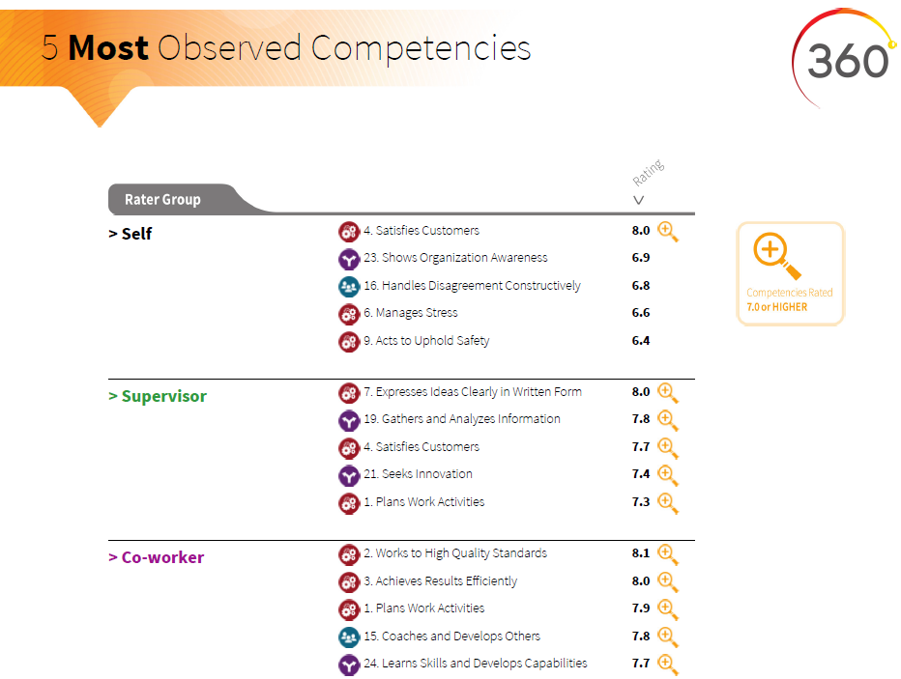
Competencies raters see the most
5 Most Observed Competencies for each rater group
Page 11
Notes:
See page 16 in the Psychometrics 360 User’s Guide for Interpretive Tips

Slide 16
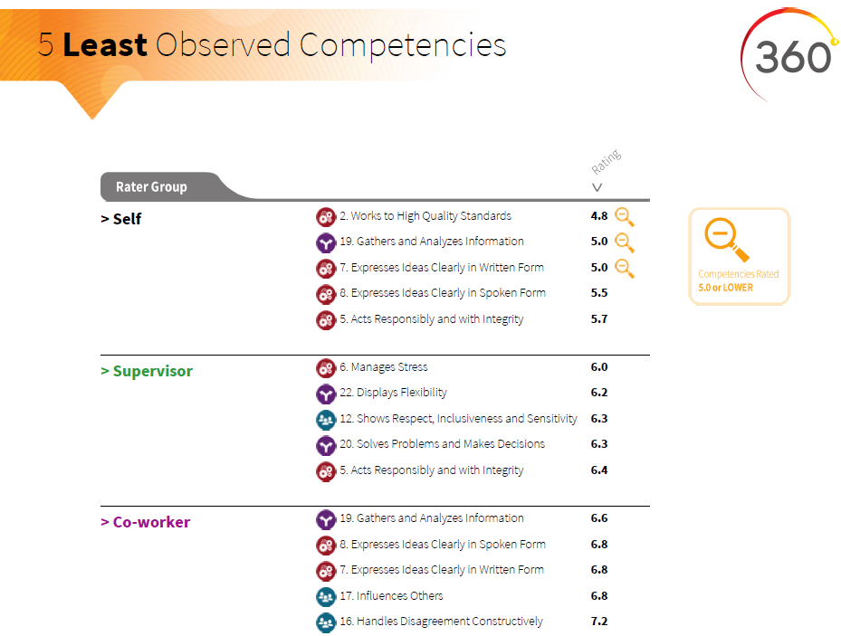
Competencies raters see the least
5 Least Observed Competencies for each rater group
Page 12
Notes:
See page 16 in the Psychometrics 360 User’s Guide for Interpretive Tips

Slide 17
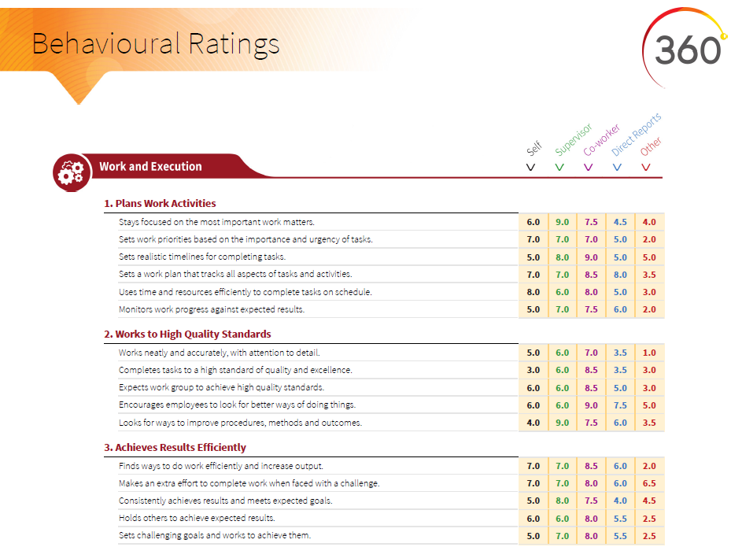
Digging Deeper
Behaviour Ratings
Pages 13-18
Notes:
See page 17 in the Psychometrics 360 User’s Guide for Interpretive Tips

Slide 18
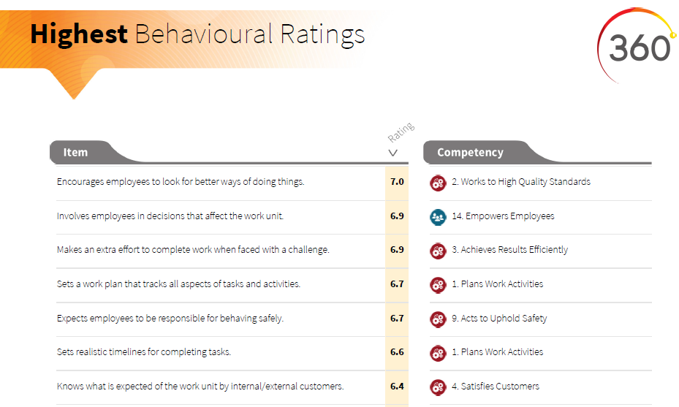
15 Most Frequent Behaviours
The 15 behaviors that all raters see from you the most.
Rating is the average response across all raters.
Notes:
See page 17 in the Psychometrics 360 User’s Guide for Interpretive Tips

Slide 19
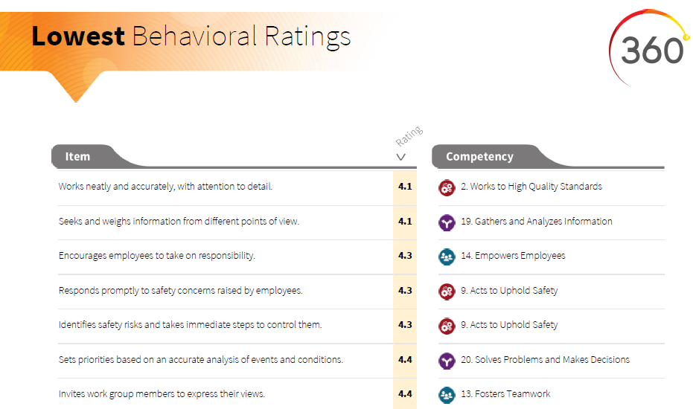
15 Least Frequent Behaviours
The 15 behaviors that all raters see from you the least.
Rating is the average response across all raters.
Notes:
See page 17 in the Psychometrics 360 User’s Guide for Interpretive Tips

Slide 20
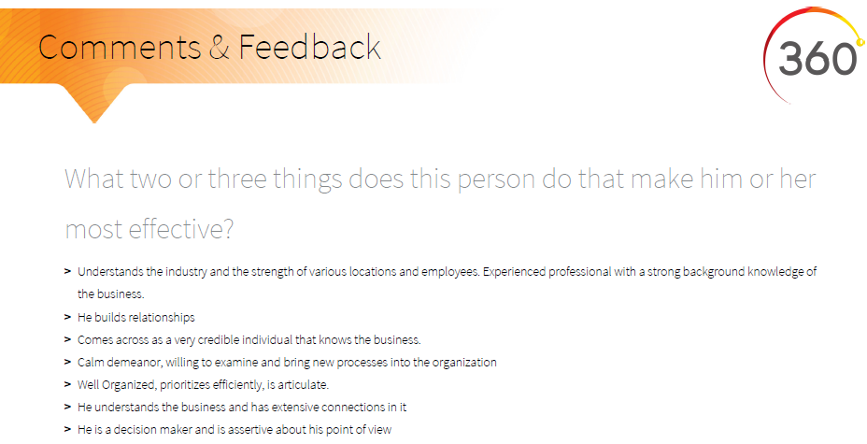
Comments
Personal feedback from raters
Focus: Look for patterns of strengths & developmental needs
Notes:
See page 18 in the Psychometrics 360 User’s Guide for Interpretive Tips
What two or three things does this person do that make him or her most effective?
What new skills or behaviours would make this person even more effective? Consider today’s needs and future needs.
What other comments do you have to aid in this individual’s personal insight and development?
Recommendations:
-Take time to digest comments; don’t react right away
-Look for patterns/themes
-Don’t just focus on negative or areas for improvement; good leaders leverage their strengths!
-Remember, your raters are not professional writers; some comments can/should be ignored

Slide 21
Next Steps?
For further information, contact Psychometrics Canada at
1-800-661-5158 info@psychometrics.com

