Slide 1
Leveraging Team Dynamics
Insights & Tools for HR Leaders

Slide 2
The Search For Team Effectiveness
Notes:
Throughout my career, I’ve seen a lot of organizations trying to figure out what makes an effective team.
However, the code has not yet been cracked.
A great example is Project Aristotle (Google).
Initially in the project, they were having a hard time finding any patterns, or (NY Times article) “any evidence that the composition of a team made any difference”.
They began to focus on group norms, but found that “the norms of one effective team contrasted sharply with those of another equally successful group”.
A lot of this research and exploration reminds me of articles that I’ve written about connected and disconnected cultures.
I’ve proposed that there isn’t a “good” or “bad”, just internal cultures that work for groups (which may not work for others).
However, each culture or group norm has elements that can be broken down further.
That’s where we get to concepts like communication, change and conflict.
Of course, there are more than just these 3 elements that can influence team effectiveness.
But everyone needs a starting point. And these 3 factors are a powerful place to start.
In today’s webinar, I would like to:
Share a different, data-driven way to approach these three topics
Explore a case studies where the data has been used to improve team cohesion
Look at what we can learn from a large sample

Slide 3
Communication
Notes:
It’s well-established that communication is one of the cornerstones of a successful organization.
Good communication has plenty of benefits, but the definition of “good” varies.
What is good to me may not be good to you.
“Good” is often based on our own communication preferences.
“Good communication” is delivered in a method that suits the individual, with content that resonates with them.
But we’ve established many times over that not everyone is the same. What are some of the preferences that individuals have? How can we speak to them?

Slide 4
Your Style
Notes:
Before we explore 4 different communication styles, I want you to make a prediction for yourself. Consider the following two factors:
Are you more extraverted or introverted?
Do you like focusing on the concrete details, or the big picture vision?
I’ll cover the 4 styles using an example.

Slide 5
Communication Style
Extraverted Visionaries
Extraverted Realists
Reflective Visionaries
Reflective Realists
Notes:
Reflective Visionaries
Self-prediction: Introverted + Big Picture
Focus on: Vision of the future, ideas and possibilities, what could be
Potential Derailer: Not taking the time to explain their ideas to others
Example: This was the majority style for the team. As a result, the team focused on future possibilities and what could be, but sometimes assumed that everyone else were on the same page. As a result, the Realists struggled to understand how some ideas could be achieved.

Slide 6
Communication Style
Extraverted Visionaries
Extraverted Realists
Reflective Visionaries
Reflective Realists
Notes:
Reflective Realists
Self-prediction: Introverted + Details
Focus on: Clarifying important details, eliminating uncertainty and ambiguity, what is
Potential Derailer: Overwhelming others with details
Example: This was the secondary style for the team, and this created some communication issues. They tended to start with the details…a lot of details. An overwhelming amount of details. This left some of the team lost and confused.

Slide 7
Communication Style
Extraverted Visionaries
Extraverted Realists
Reflective Visionaries
Reflective Realists
Notes:
Extraverted Realists
Self-prediction: Extraverted + Details
Focus on: Implementation and execution, needs and challenges, what is
Potential Derailer: Not linking current activities to strategic plans
Example: This was the minority style of the team. Being completely outnumbered by the Reflective folks on the team, they had to slow down and wait for others to contribute before they did (in order to give everyone else the time to think it through).

Slide 8
Communication Style
Extraverted Visionaries
Extraverted Realists
Reflective Visionaries
Reflective Realists
Notes:
Extraverted Visionaries
Self-prediction: Extraverted + Big Picture
Focus on: Broad goals, opportunities for the future, what could be
Potential Derailer: Pragmatic considerations
Example: This was the gap on the team, as there weren’t any. Could someone with this style have balanced the team? Maybe.

Slide 9
Communication Styles (n=113,755)
Notes:
What did that team learn? Balance.
First, they understood why each other communicated in the way that they did. This relieved some of the tensions.
From there, they were able to establish a way of communicating that worked for them.
The Reflective Realists showed a little more restraint in the amount of information they provided. They still started with the details, but the Visionaries understood that they were working their way to the big picture. The Realists just tried to get there a little quicker.
The Visionaries would ask for support in converting their ideas to concrete plans. This ensured that they were explaining the whole idea and ensuring that everyone was actually on board.
So, those are 4 potential styles of communication.
But we’re not always just working within our own teams, sometimes we’re working with other teams internally or with external clients.
What does the wider population look like? What can you expect from others? What styles might you encounter the most? What might you need to speak to the most?
I wanted to answer these questions for myself, so I gathered a sample of 113,755 individuals.
Respondents are from the Canadian population.
The most common are the Extraverted Realists, followed by their Reflective cousins. They make up 82% of the general population.
Focus on concrete and abstract.
Focus on the here and now, the needs and challenges. The “What Is”.

Slide 10
Change
How effectively does your organization support employees during times of change?
Notes:
The next C is for “Change”.
Change is a common challenge that organizations face.
Flux in the market, growth in the business, new technologies…there are many times where organizations will need to either implement or manage change.
Not everyone is as comfortable with either implementing or managing change though.
Some individuals may feel like things are changing too fast, while others may feel like things are changing too slowly.
It’s hard to keep everyone happy and to keep everyone up to speed. But it’s possible.
2020 People Trends data: Supporting employees
One way to better support your team is to understand how people approach change.

Slide 11
Your Style
Notes:
Before we dive into the different change styles, I would like you to consider the following two questions about yourself:
How comfortable are you with implementing change? When you have control. A little, somewhat or a lot?
How comfortable are you with managing change? When you have less control. A little, somewhat or a lot?
Keep your answers in mind as we explore the following 5 Change Styles within the context of a case study.

Slide 12
Change Style
Adaptable Contributors
Change Catalysts
Incremental Improvers
Status Quo Stalwarts
Change Drivers
Notes:
Change Catalysts
Comfortable implementing and managing change.
Style: Stay on top of the latest trends and push for change.
Derailer: Changing too quickly, not giving people enough time to adjust, and leaving others behind
Example: This was the dominant style of the team. While it worked for some of the team, the Status Quo Stalwarts were beginning to feel left behind.

Slide 13
Change Style
Adaptable Contributors
Change Catalysts
Incremental Improvers
Status Quo Stalwarts
Change Drivers
Notes:
Change Drivers
Comfortable implementing change, but not so comfortable managing it.
Style: Open to directing change and thinking of new ways to do things, but dislike adjusting to change they can't influence.
Derailer: Struggling to adapt to abrupt changes initiated by others
Example: Comfortable with implementing change and had the say, so they were backing the Change Catalysts.

Slide 14
Change Style
Adaptable Contributors
Change Catalysts
Incremental Improvers
Status Quo Stalwarts
Change Drivers
Notes:
Status Quo Stalwarts
Not always comfortable implementing or managing change.
Style: Focused on maintaining current processes and harnessing proven solutions.
Derailer: Saying “this is how we have always done it.”
Example: They were not comfortable with the rapid pace of change, because by the time they caught up, things were changing again.

Slide 15
Change Style
Adaptable Contributors
Change Catalysts
Incremental Improvers
Status Quo Stalwarts
Change Drivers
Notes:
Incremental Improvers
Comfortable implementing and managing change.
Style: Improve things by building on what currently exists.
Derailer: Not recognizing when larger changes are required for longer-term solutions
Example: They were able to act as the bridge between the Change-motivated individuals and the Status Quo Stalwarts. Instead of sweeping changes, how can we improve what we have?

Slide 16
Change Style
Adaptable Contributors
Change Catalysts
Incremental Improvers
Status Quo Stalwarts
Change Drivers
Notes:
Adaptable Contributors
Comfortable managing change, but maybe not so much implementing it.
Style: Comfortable adapting to change, but not the driving change initiatives.
Derailer: More reactive than proactive
Example: While no one was this style in the group, they likely would have been comfortable going with the flow.

Slide 17
Change Styles (n=113,755)
Notes:
What happened with this team?
The Status Quo Stalwarts asked for more structure. This helped improve the amount of change that was happening at the same time, which became more comfortable for everyone.
The Change-focused individuals realized that they were leaving some individuals behind. This additional planning helped them ensure that their ideas were refined (and necessary) before implementing.
As much as many of us would like to be Change Catalysts (because it’s appealing in a high innovation world), not everyone is.
And this is ok! It’s not a bad thing. Without the variety of styles, we would forever be changing for the sake of change.
Each style provides their own unique contribution, and we need the balance.
How are the change styles distributed within the Canadian sample?
30% of the sample are Status Quo Stalwarts: They prefer smaller or fewer changes to occur.
28% are Change Drivers: They are comfortable implementing change, but maybe not as comfortable with adapting to chance forced on them.
23% are Incremental Improvers: They like to improve things in a step-by-step manner, and are most comfortable with changes that are implemented in the same way.
This covers 81% of the sample.

Slide 18
Conflict
When does conflict occur the most?
Notes:
The final C is for Conflict.
Data from the 2020 People Trends Report
Top issues are those where flexibility or adaptation is needed (higher stress situations, e.g. times of change).
Disagreements can also occur during routine operations, but less often (differences of opinion).
Less conflict occurs when trying to plan in advance.
There are 5 main styles that individuals tend to gravitate towards when faced with conflict.
It’s not that this is the only style they can use, but it’s the one that they default to.
It’s the most comfortable style, and maybe the one that they’ve seen the most success when harnessing in the past.
Instead of having you predict your preferred conflict style, let’s see what the group looks like before we look at the research sample data.
So, as we go through the 5 styles, consider which styles you may be harnessing the most often.
I’m also going to take you through an example of a group that I’ve worked with.
Unfortunately, this group wasn’t using the conflict styles in an ideal way, so it created some challenges initially.

Slide 19
Conflict Style
Persuaders
Builders
Negotiators
Evaders
Harmonizers
Notes:
Evaders
Approach to Conflict: Avoiding conflict, putting conflict aside to return when tensions have cooled
Contributions: Reducing tensions, seeing that the conflict might be the by-product of a larger issue.
Overdependence: Putting off conflicts for too long and letting resentment build.
Example: This was the group’s primary style, though they did not use it in an effective manner. They tended to avoid the conflict when they could.

Slide 20
Conflict Style
Persuaders
Builders
Negotiators
Evaders
Harmonizers
Notes:
Harmonizers
Approach to Conflict: Identify and accommodate the desires of others
Contributions: Building cohesion and good will in teams. Willing to adopt other’s ideas.
Overdependence: Sacrificing their own needs. (Extreme case: Letting others walk over them.)
Example: This was the group’s secondary style. If conflict needed to be resolved, they would accommodate to the needs of others, ignoring their own.
Between evading and accommodating, they weren’t often getting the resources that they needed, and resentment was building up.

Slide 21
Conflict Style
Persuaders
Builders
Negotiators
Evaders
Harmonizers
Notes:
Negotiators
Approach to Conflict: Searching for solutions that meet some of everyone’s needs (middle ground)
Contributions: Identifying acceptable solutions in a timely manner. Implementing temporary solutions until a more comprehensive solution can be identified.
Overdependence: Focusing on the short-term resolution at the expense of the big-picture perspective
Example: There was one person on the team whose primary style was to Negotiate. They often felt frustrated because everyone was trying to avoid conflict in some manner, rather than address it.
Again, due to conflict not being addressed and needs not being met, they were starting to feel resentful.

Slide 22
Conflict Style
Persuaders
Builders
Negotiators
Evaders
Harmonizers
Notes:
Persuaders
Approach to Conflict: Convince others and argue their point of view
Contributions: Pushing for resolution
Overdependence: May be seen as inflexible and unwilling to compromise
Example: There were no Persuaders in the group that I worked with, which meant that they spent most of the time either evading conflict or accommodating when they couldn’t evade.
Ultimately, the leader of the team was tasked with this role, though she wasn’t comfortable with doing so. But there were things that her team needed that she had to push for.

Slide 23
Conflict Style
Persuaders
Builders
Negotiators
Evaders
Harmonizers
Notes:
Builders
Approach to Conflict: Finding solutions that are mutually beneficial. Listen, share, and incorporate all points of view.
Contributions: Pushing for win-win solutions
Overdependence: May devote too much time trying to find consensus
Example: There were no Builders in the case group either, which meant that win-win solutions were rarely emerging from conflict.

Slide 24
Poll #2 (Case Study Result)
Notes:
Ultimately, the team needed to start addressing conflict directly (in a constructive way), rather than letting it linger.
Instead of evading conflict, they started to use this opportunity to gather their thoughts and bring them back to the table.
Instead of accommodating when they needed to address conflict, they started to discuss what they would need to reach a win-win solution, or at least a middle ground.

Slide 25
Conflict Styles (n=113,755)
Notes:
Which conflict styles are we most likely to encounter in the wider world? Which are the least likely?
50% of the sample were Builders: When it seems like others might be taking too long to resolve the challenge at hand, it may be because they’re trying to find a win-win solution.
33% are Negotiators: They might be the ones to step in and say “Hey, a win-win might not work here, we may need to find a middle ground.”
That covers 83% of the sample, suggesting that you may see fewer Harmonizers, Evaders and Persuaders (depending on your industry and organization).

Slide 26
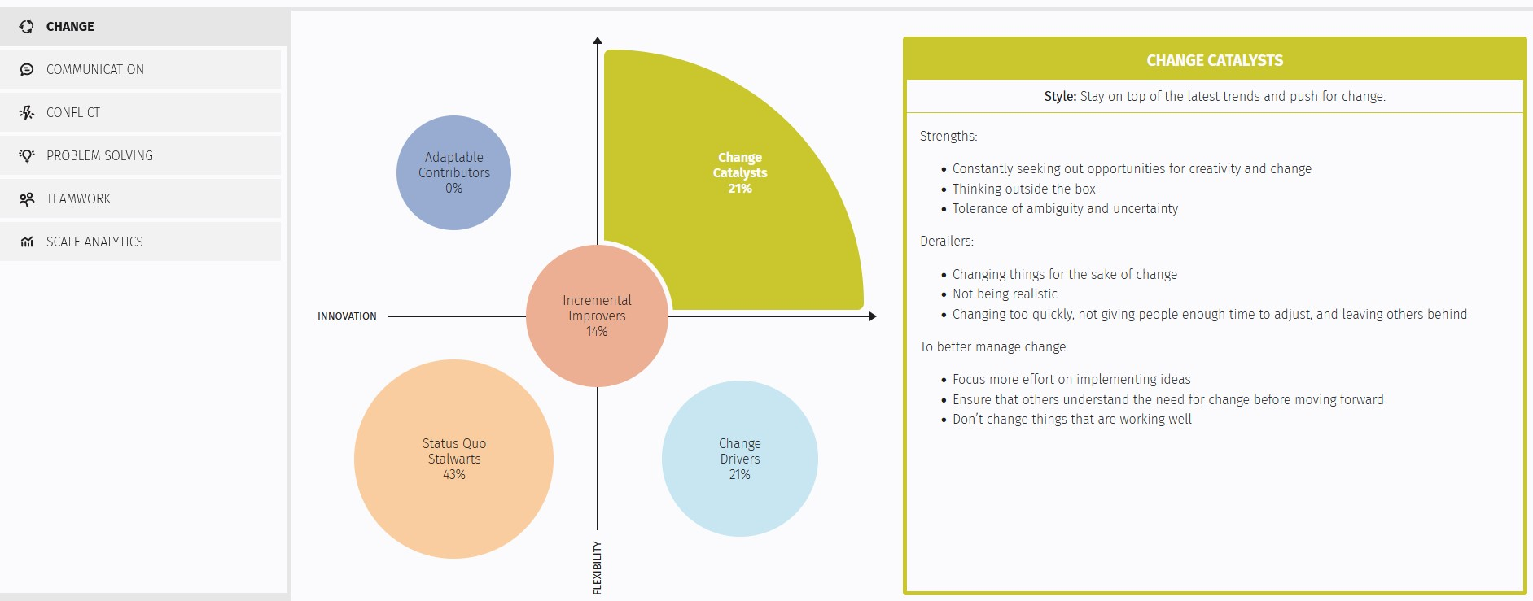
How do I get these insights?
Notes:
How do I get these insights for my team? How did you gather these insights?
You’re in luck. All of the information presented about these topics can be found in our Team Dynamics platform.
Team Dynamics
Team Dynamics is a self-guided platform where team members can explore their own results and learn about how they contribute to their team
Team Leaders use this platform to get this insights into their own team, and understand where strengths or gaps exist.
HR and L&D professionals use Team Dynamics to help teams and their organization gain these insights in a scalable manner.

Slide 27
Some topics of Exploration
Exploring topics and challenges
Exploring with your team
Which methods of communication do you overuse? Underuse?
What could you do to better guide others during times of change?
How might your approach to conflict come across to members of your team?
Where are we balanced? Imbalanced?
What does our team tend to overdo?
What gaps do we need to consider/fill?
How is our team perceived by others?

Slide 28
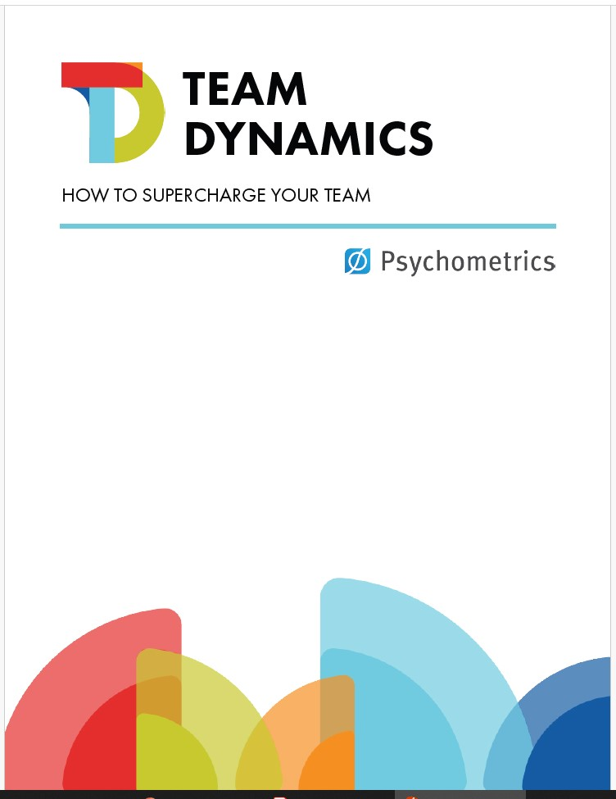
Team Dynamics Guide
Notes:
What about questions for specific topics, such as communication, change and conflict? How can we explore these in a deeper way?
We have you covered.
After the recording and the slides have been sent to you, everyone registered will also receive a guide that will provide a detailed way for you to dive into each topic with your team.

Slide 29



Connecting With Us
www.psychometrics.com
jdeonarine@psychometrics.com
@Psychometrics-Canada
Justin Deonarine Organizational Psychologist

